Slide 1
CS 692 – R1 PRESENTATION
TEAM 1
MAIDEASE
Amala Natu
Tahera Shaikh
Rushda Mansuri
Bhakti Palkar
Nidhi Berde
Sai Manish Avasarala
Sai Teja Malladi
Jahid Hassan
Kaneshk K Sonee (Project Manager) Neerav Poriya (Lead Developer) Neha Chudekar (Jenkins Admin) Sayali Tandel (Lead BA) Limisha Oliveira (Product Owner)
Tushar Varma (Jira Admin) Chandini Reddy (Lead QA)

Slide 2
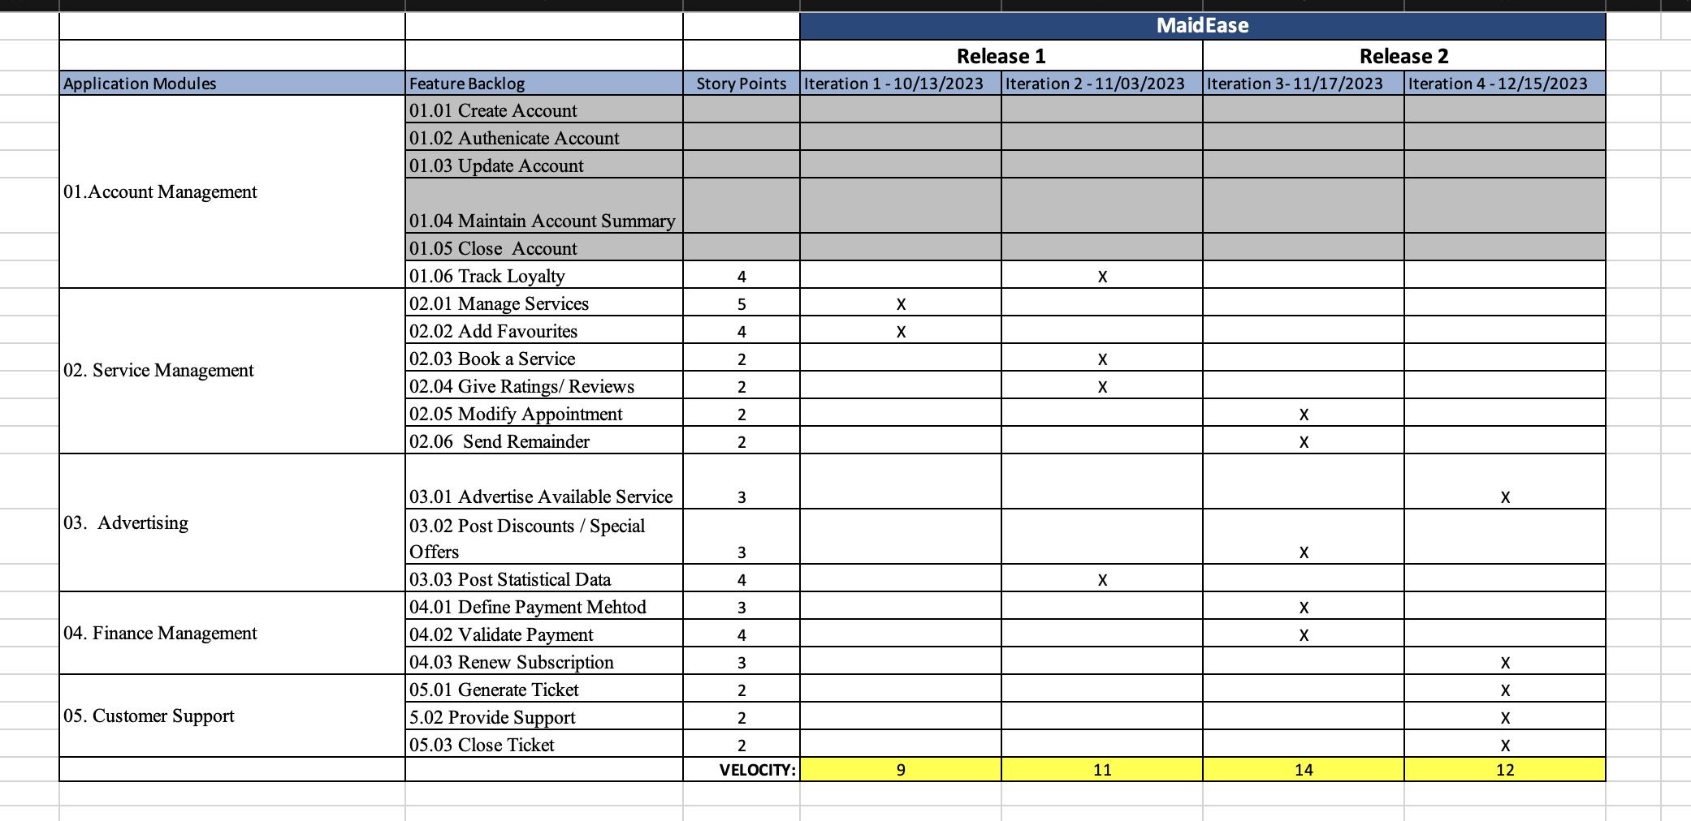
Road Map
(Limisha Oliveira)
ROAD MAP

Slide 3
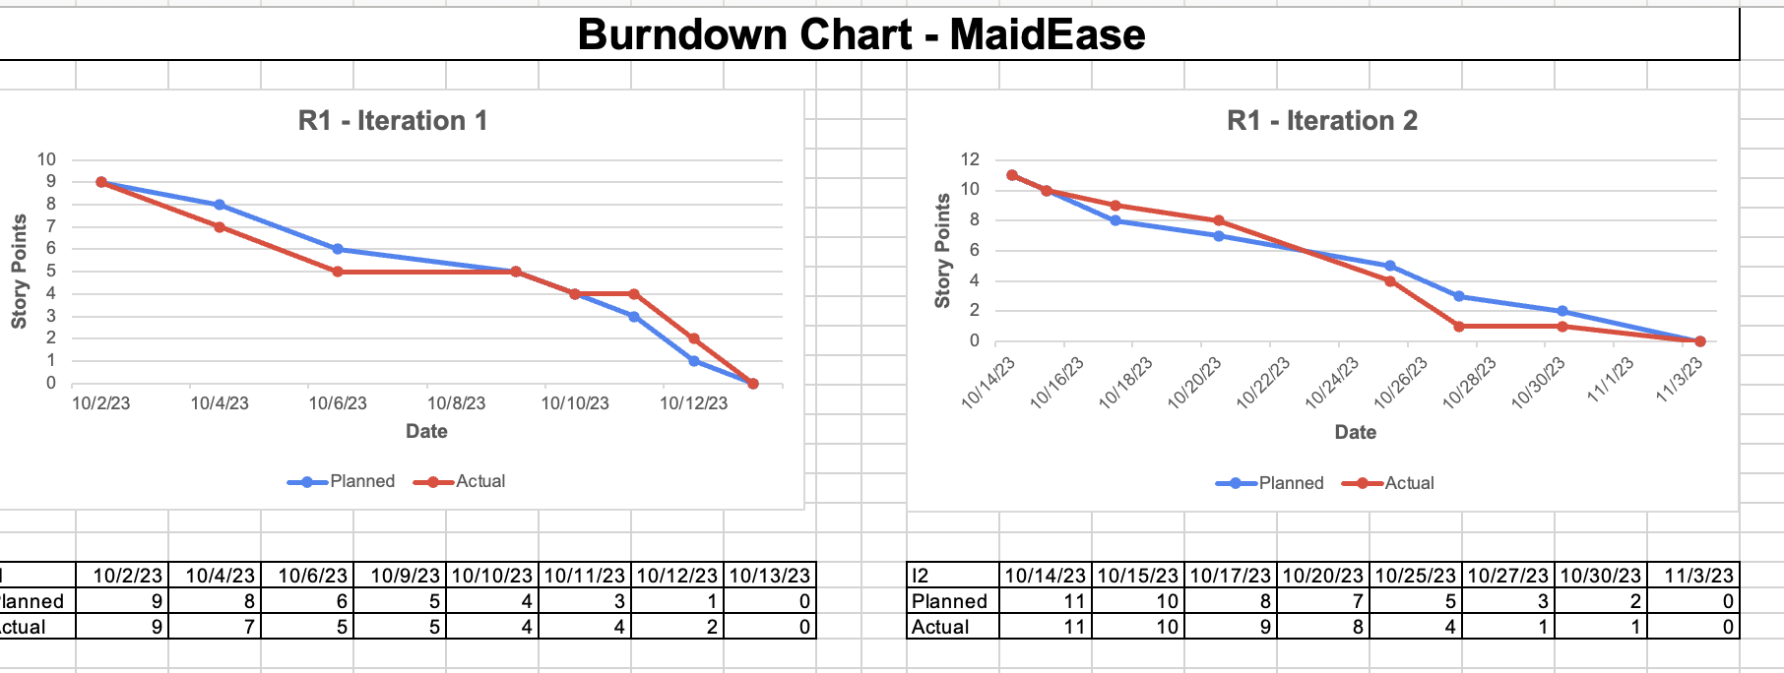
Burn Down Chart
(Kaneshk K Sonee)
BURN DOWN CHART (I1 & I2)

Slide 4
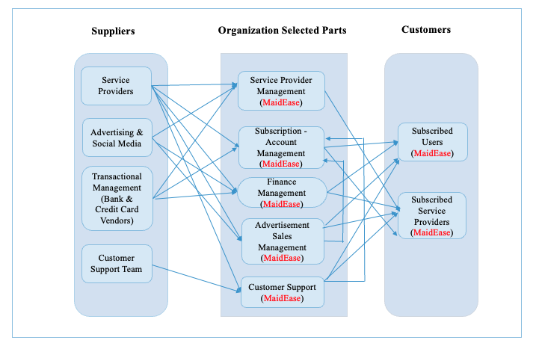
BRM Diagram (Neha Chudekar)
BUSINESS RELATIONSHIP MAP DIAGRAM

Slide 5
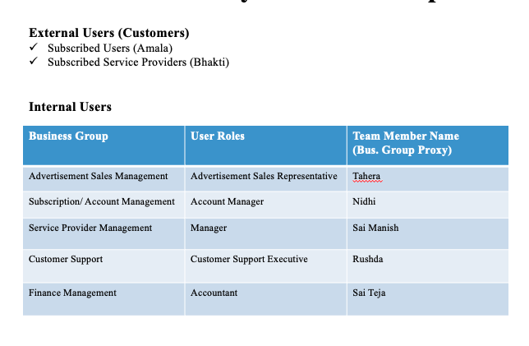
USER ROLES BY BUSINESS GROUP

Slide 6
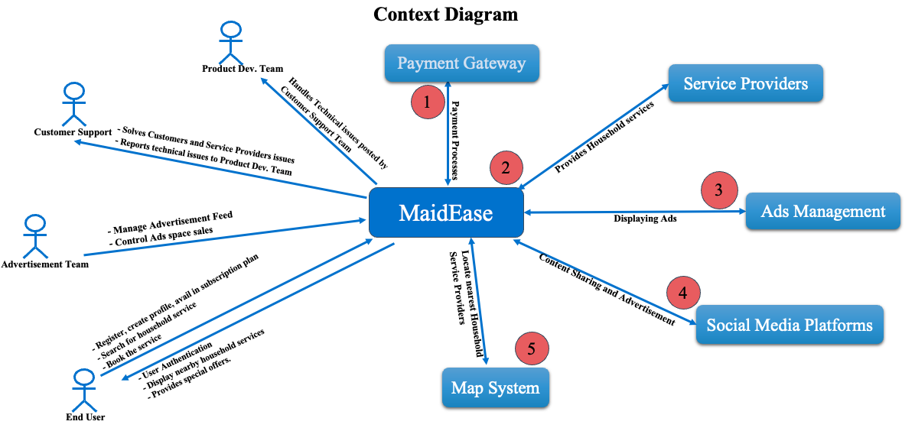
Context Diagram
(Sayali Tandel)

Slide 7
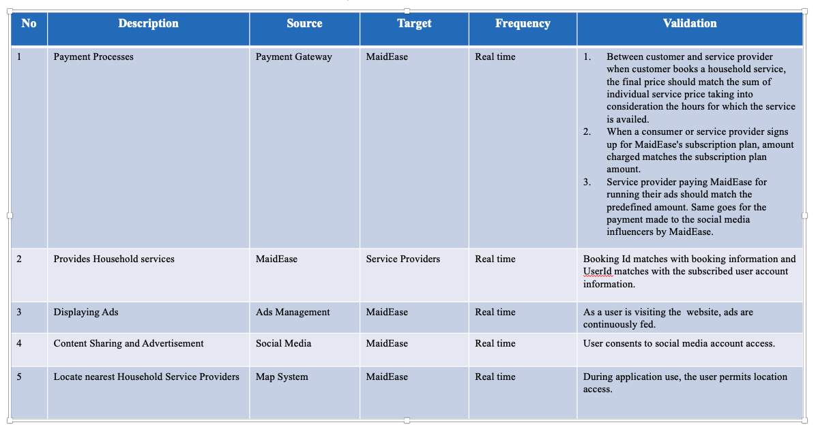
SYSTEM INTERFACE TABLE

Slide 8
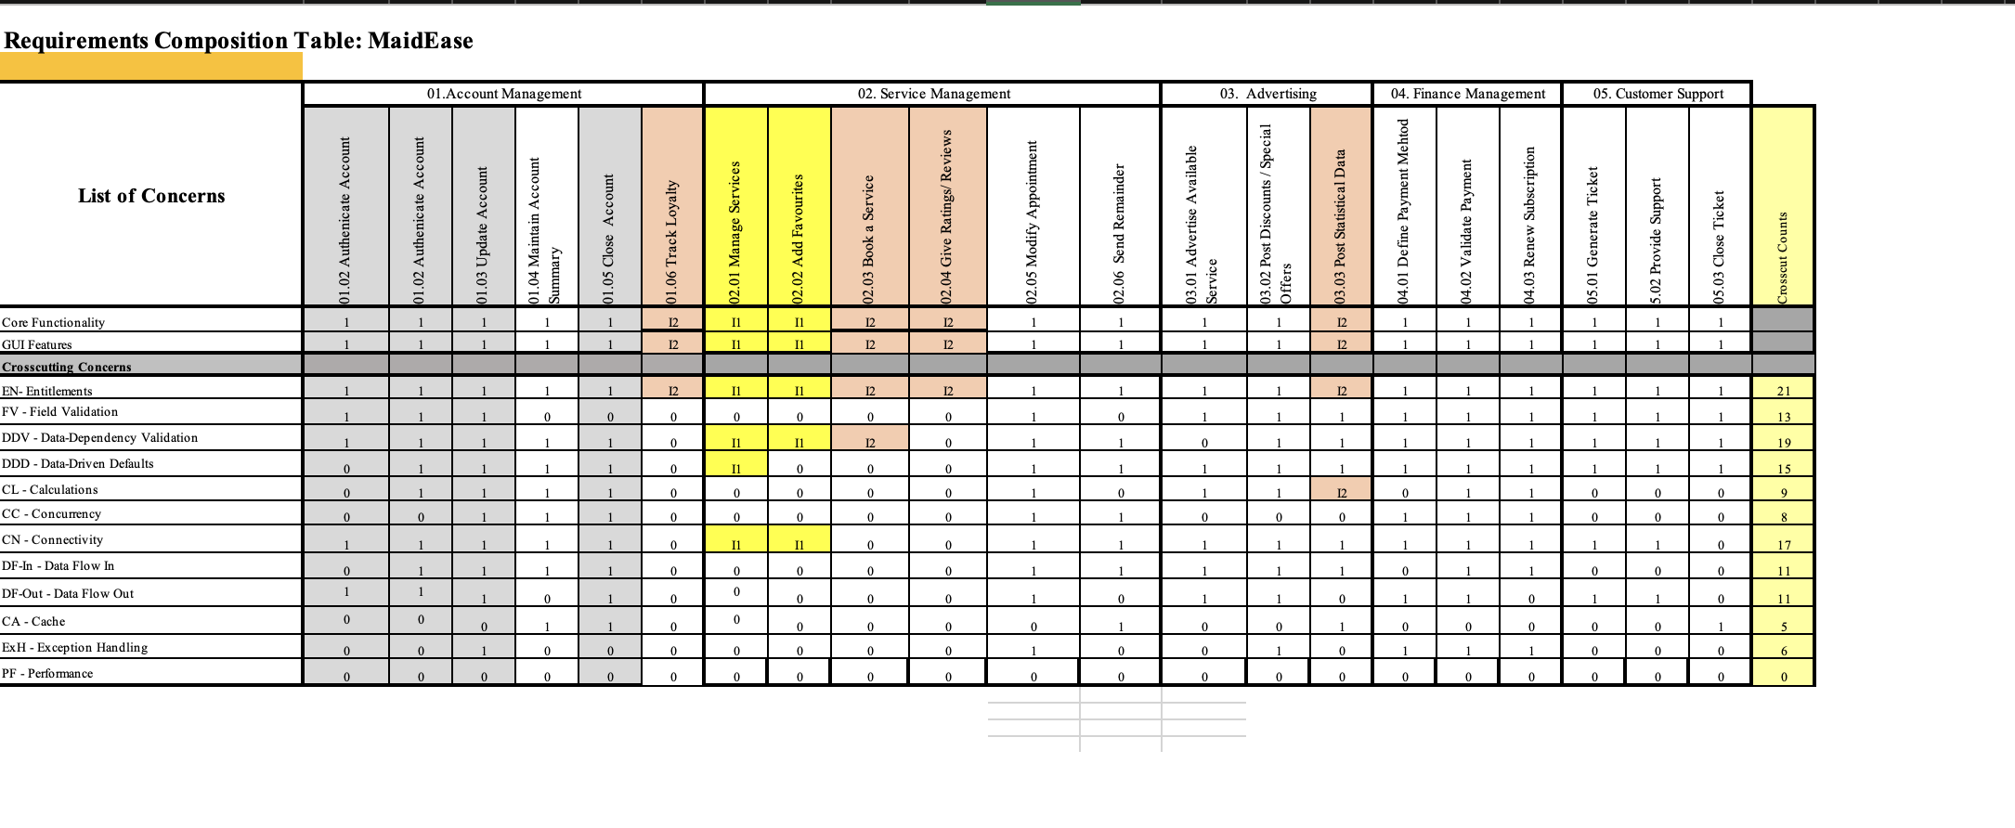
RCT Planning view
(Neha Chudekar)

Slide 9

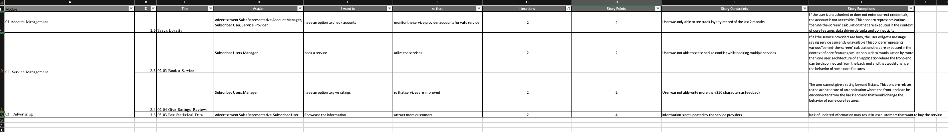
User Stories
(Limisha Oliveira)
USER STORIES (I1 & I2)

Slide 10
Test execution Log
(Chandini Reddy)

Slide 11
Recorded Demo
(Neerav Poriya)

Slide 12
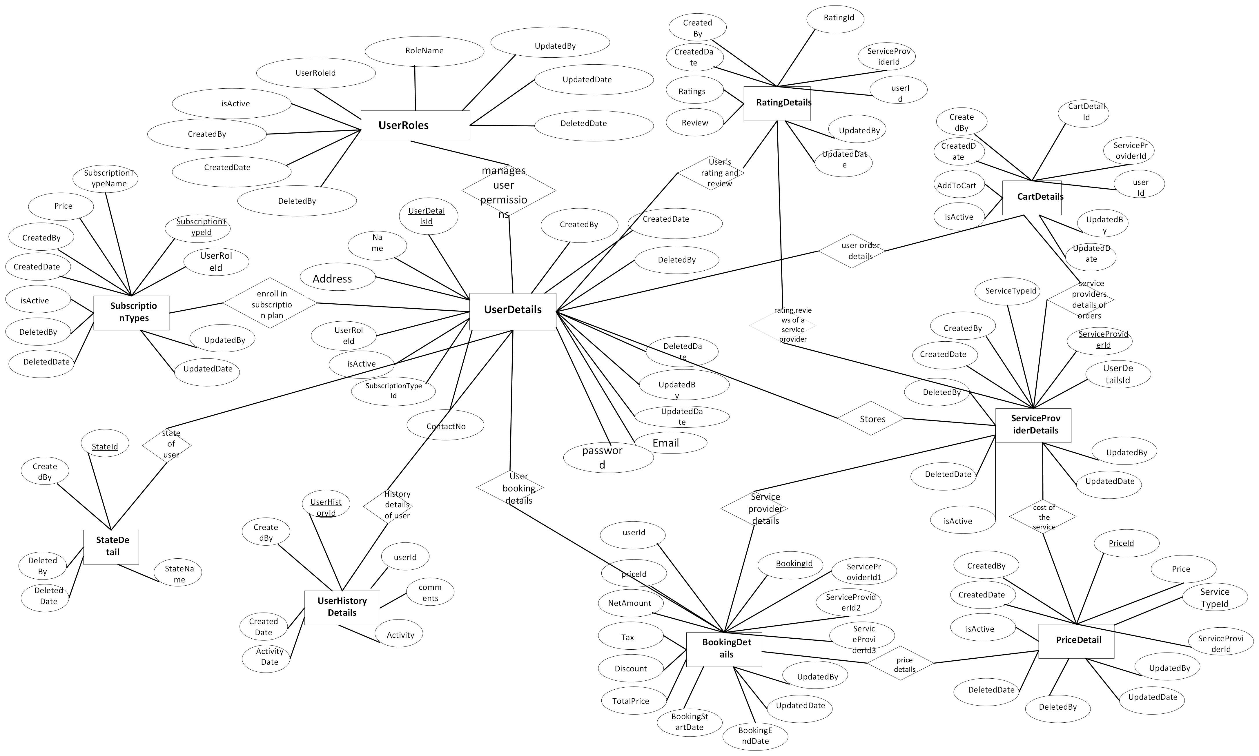
ER Diagram: MaidEase Iteration2

Slide 13
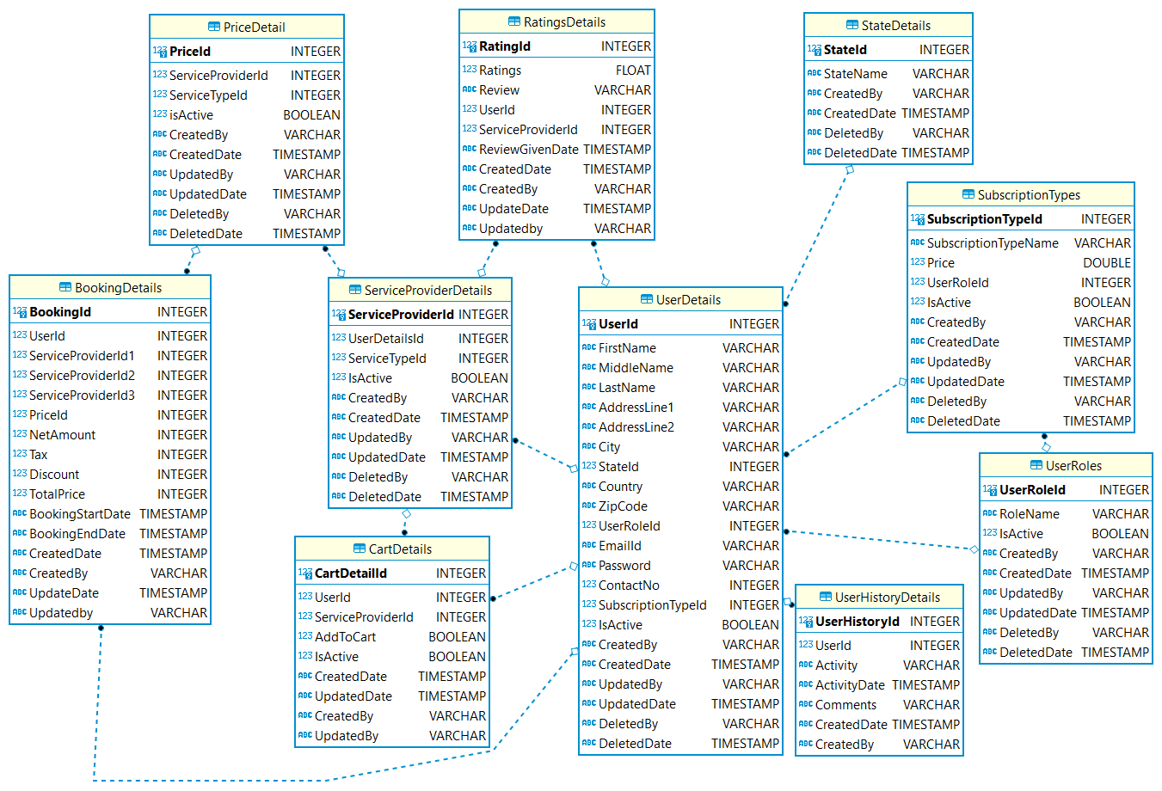
Logical Diagram: MaidEase Iteration2

Slide 14
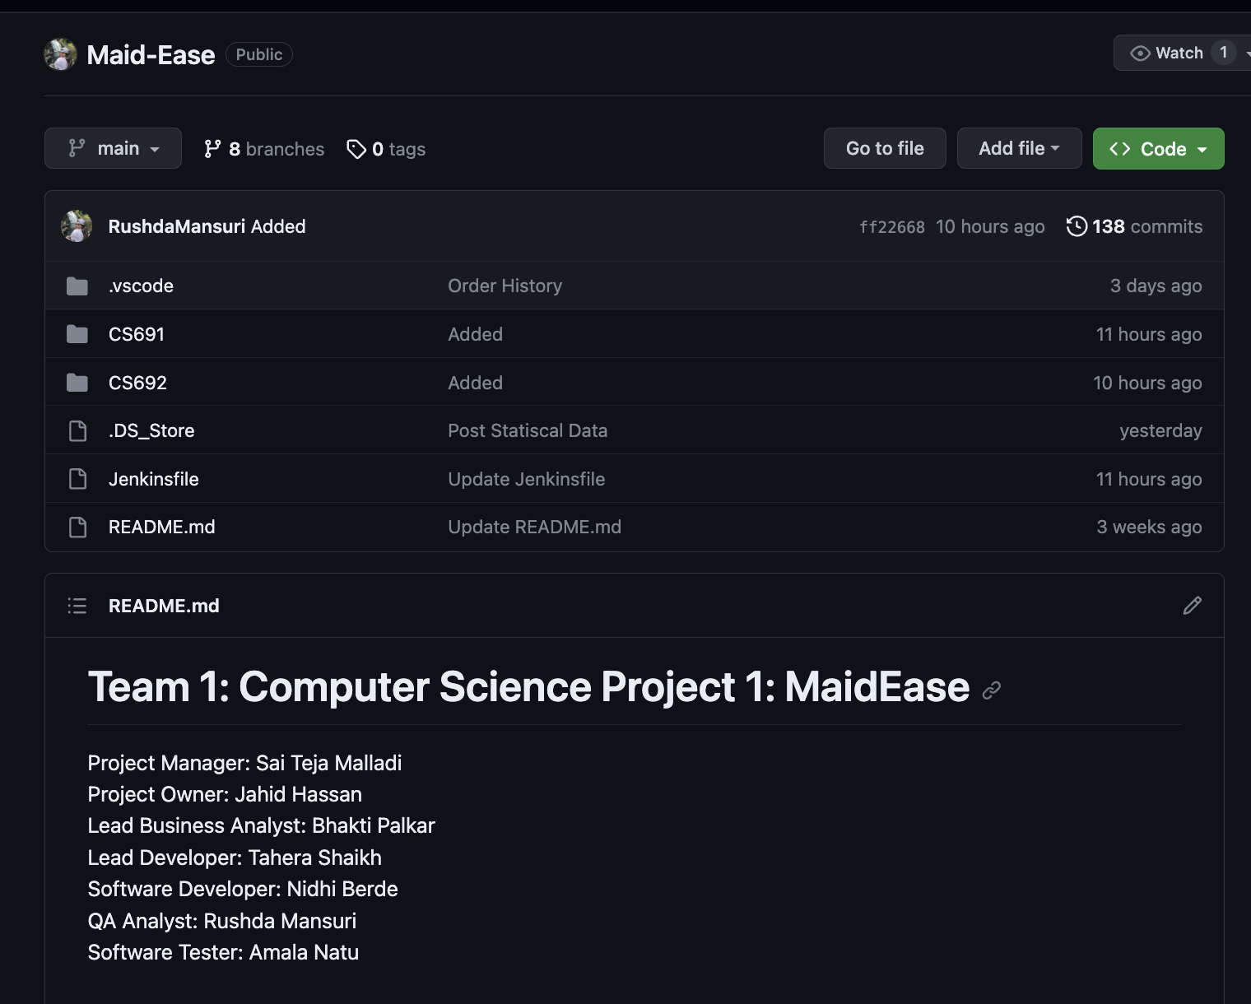
GITHUB REPOSITORY
https://github.com/RushdaMansuri/Maid-Ease

Slide 15
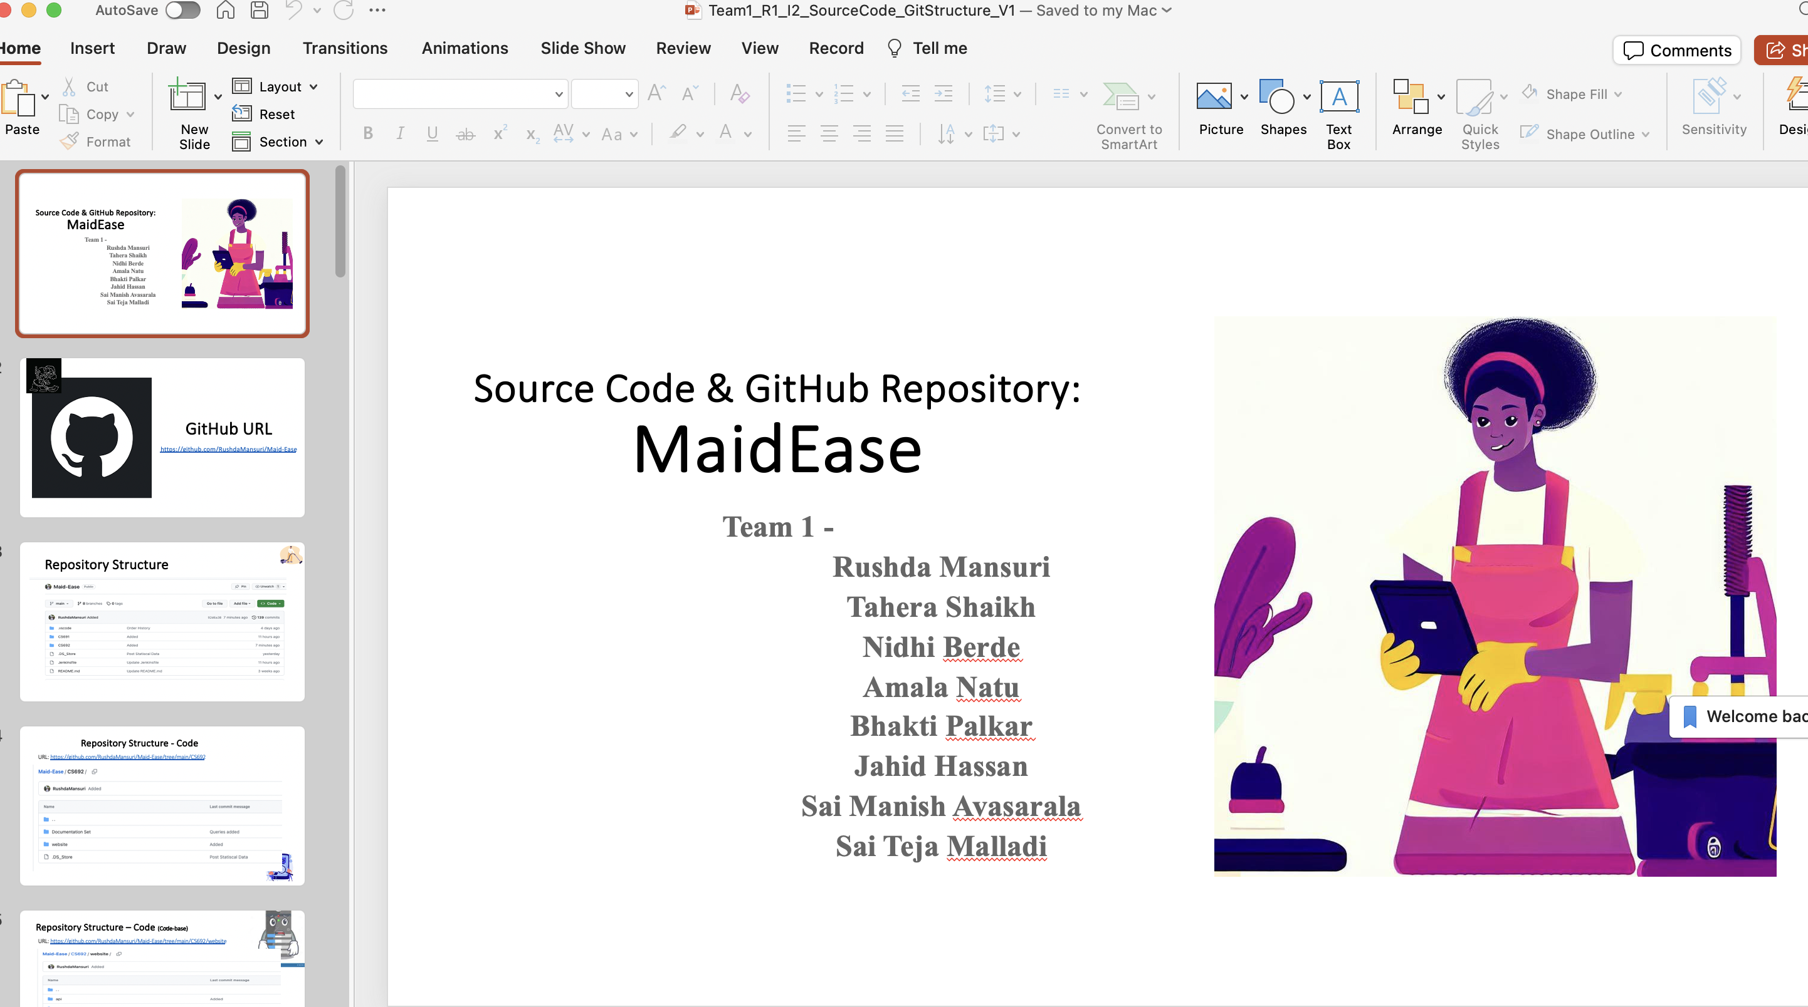
SOURCE CODE

Slide 16
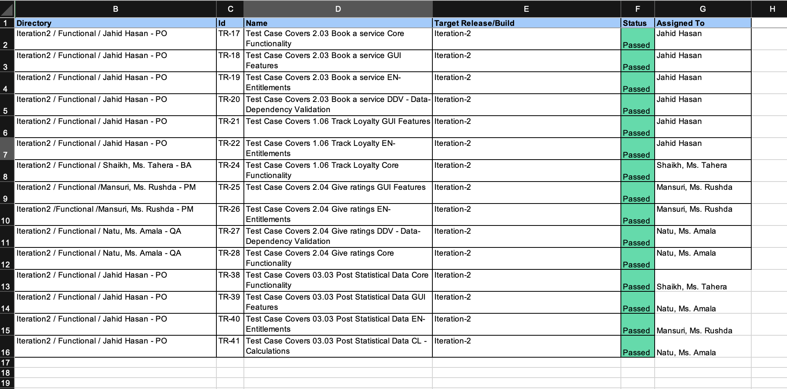
Git Hub Folder
(Tushar Verma)
TEST EXECUTION LOG

Slide 17
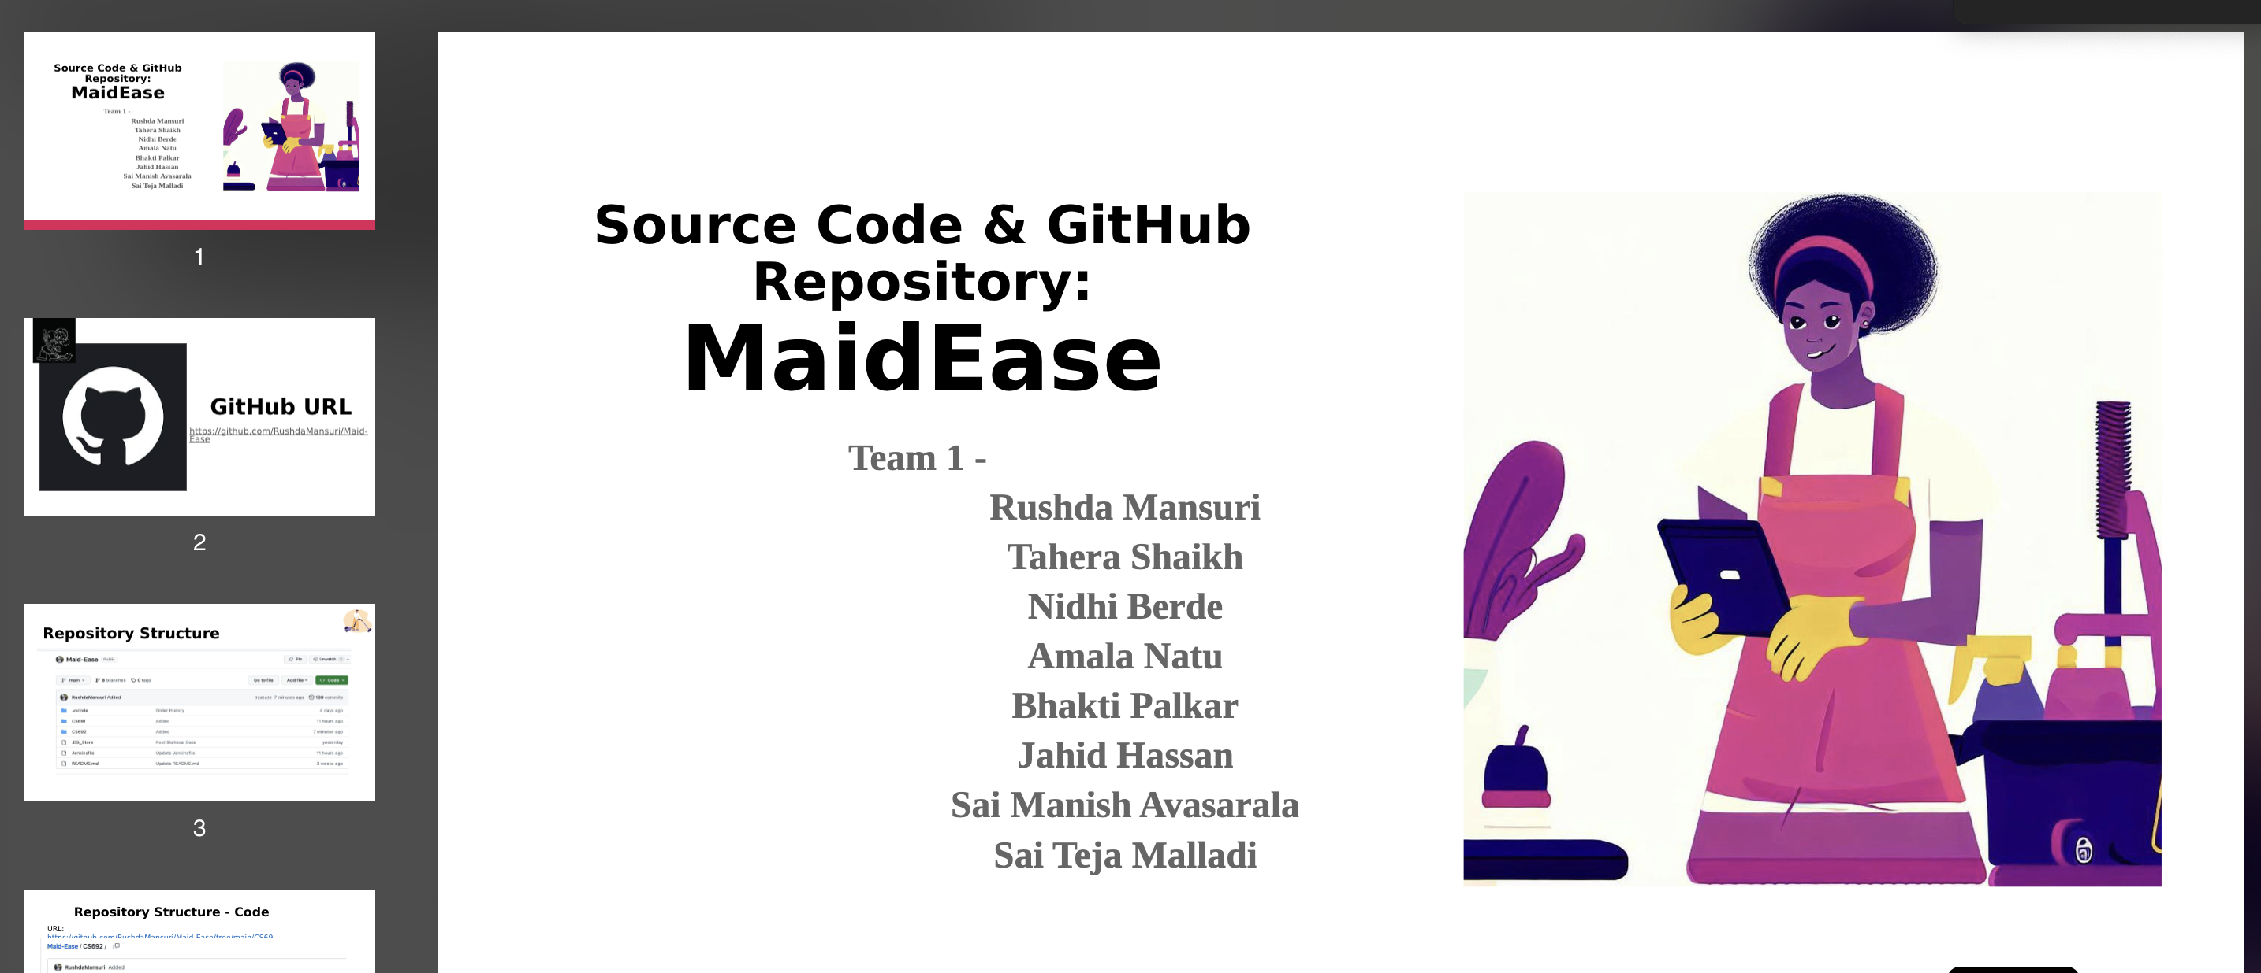
APPLICATION DEMO

Slide 18
Thank You

